Slide 1

Module 5
Tree-Based Models
Notes:
Guidelines
Use section headers to chunk content in your presentation.
Use the same style of section header throughout your presentation.
Keep your title to no more than 2 lines.

Slide 2
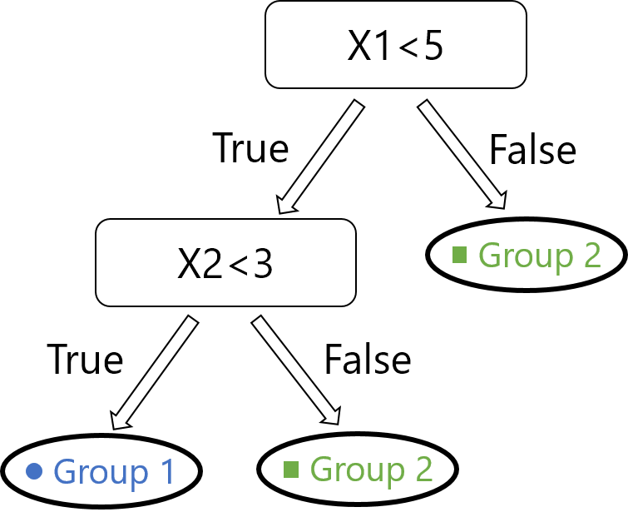
Hyperparameters
Notes:
Guidelines
Use a title slide at the beginning of your presentation. There are 9 variations of title slides to choose from.
If you will have a series of slideshows, we recommend using the same style of title slide for each presentation.
Keep your title to no more than 2 lines.
Do not change the font style or font size of the title or subtitle.

Slide 3
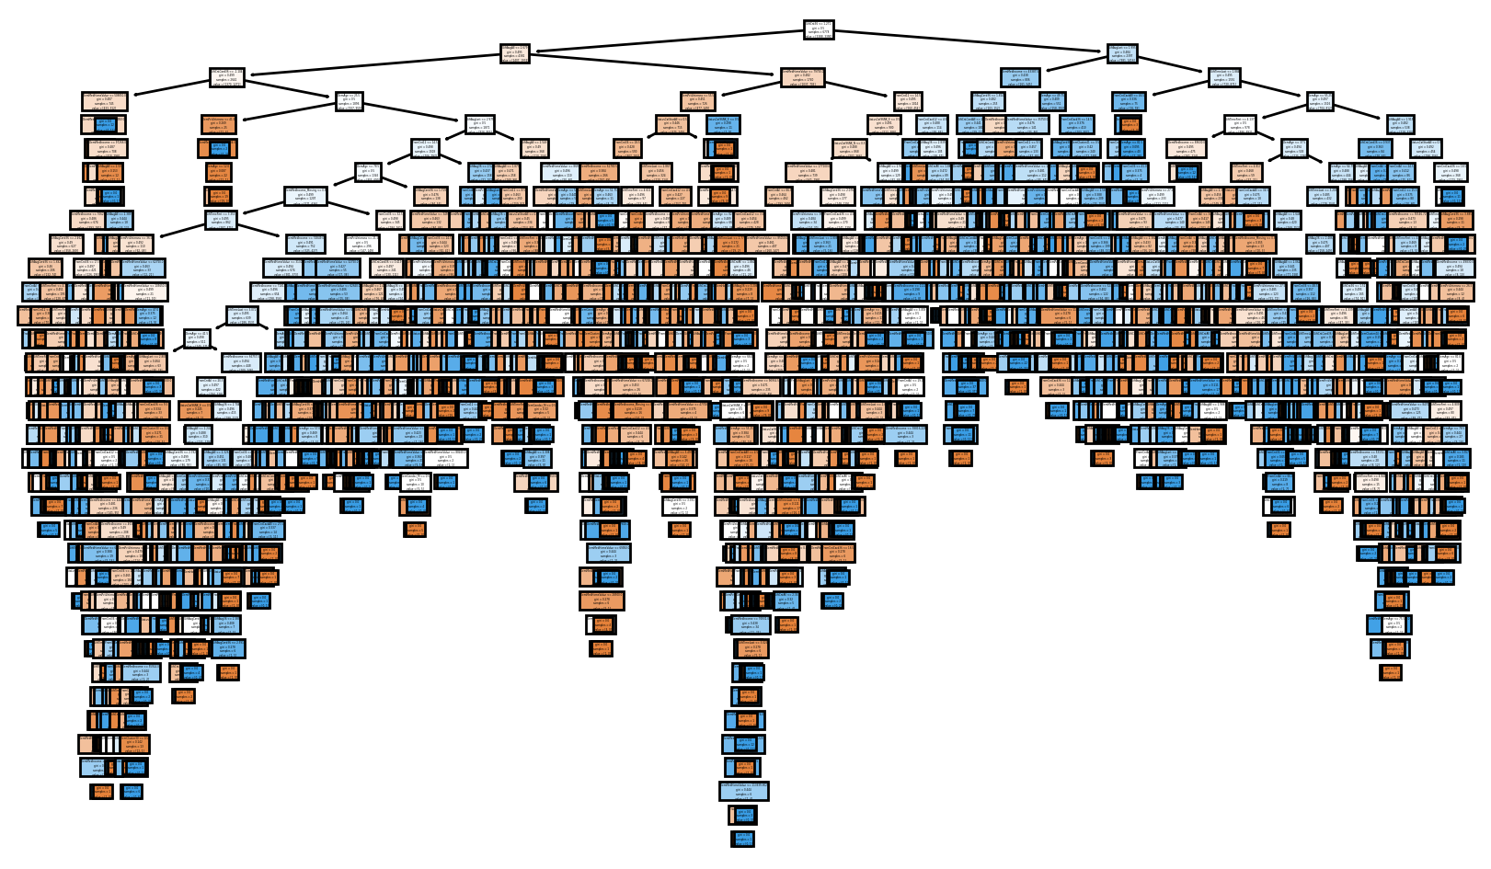
Hyperparameters
Model parameters whose value are used to control the model.
Mostly used to control tree growth (stopping criteria)

Slide 4
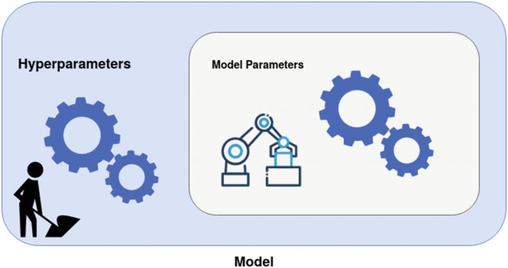
Hyperparameters vs Parameters
The estimates of slopes, coefficients are referred to as parameters.
Hyperparameters are set by user prior to fitting the model.

Slide 5
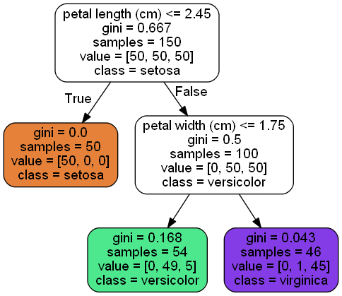
Splitting Criterion
The splitting criterion (criterion) refers to the impurity metric.
Classification
Gini Index
Entropy
Regression
MSE
Friedman MSE
MAE
Poisson

Slide 6
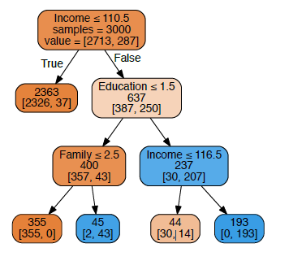
Maximum Tree Depth
How many levels a tree can go down?
We call this the depth of the tree
Depth = 1
Depth = 2
Depth = 3

Slide 7
Maximum Tree Depth
We can limit the tree growth by setting the maximum depth
max_depth = 2

Slide 8
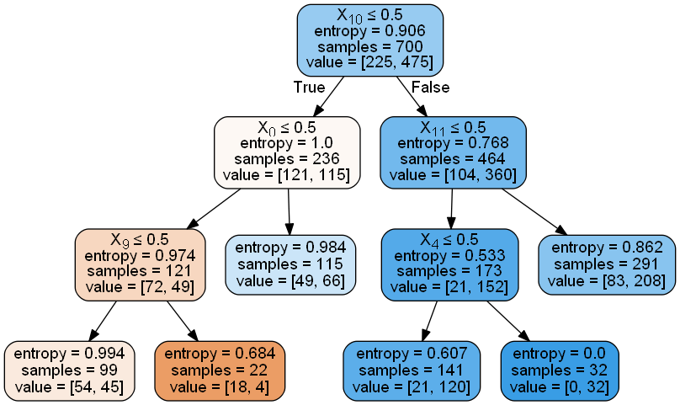
Maximum Number of Terminal Nodes
We can limit the number of leaves to a specific value
max_leaf_nodes = 6

Slide 9
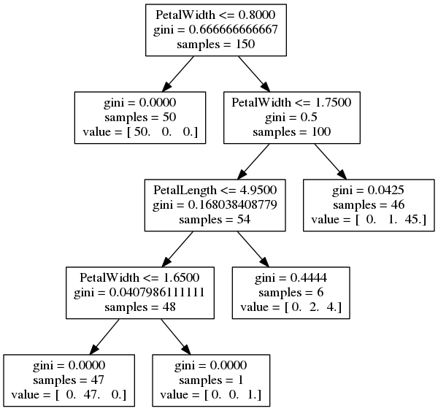
Minimum Samples
We can set a limit to number of observations needed to split node
min_sample_split = 10

Slide 10
Minimum Samples
We can set a limit to number of observations for a leaf
min_sample_leaf = 20

Slide 11
Minimum Impurity Decrease
The minimum improvement in impurity to split node
min_impurity_decrease = 0.05

Slide 12
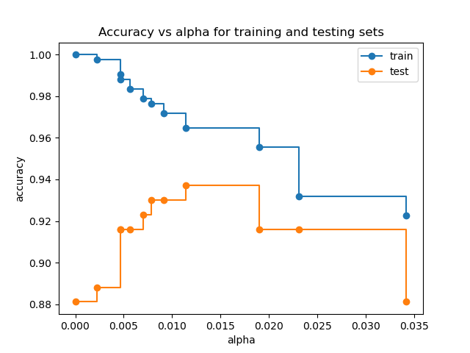
Cost Complexity Pruning
Can control pruning level based on test accuracy.
Uses alpha specifies level of pruning (higher alpha = higher pruning)

Slide 13
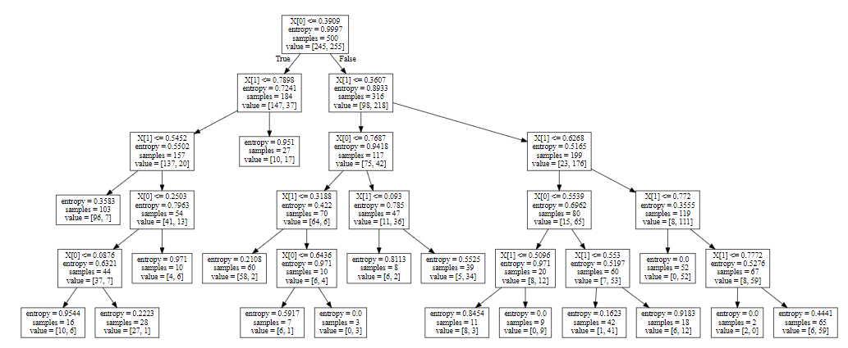
Cost Complexity Pruning
Can control pruning level based on test accuracy.
Uses alpha specifies level of pruning (higher alpha = higher pruning)

Slide 14
Python
Notes:
Guidelines
Use a title slide at the beginning of your presentation. There are 9 variations of title slides to choose from.
If you will have a series of slideshows, we recommend using the same style of title slide for each presentation.
Keep your title to no more than 2 lines.
Do not change the font style or font size of the title or subtitle.

Slide 15

Cross-Validation
Resampling method that uses different portions of the data to test and train a model on different iterations.

Slide 16
Cross-Validation
Resampling method that uses different portions of the data to test and train a model on different iterations.
check model
performance
fit

Slide 17
Cross-Validation
Resampling method that uses different portions of the data to test and train a model on different iterations.
check model
performance
Fit
Fit

Slide 18
Cross-Validation
Resampling method that uses different portions of the data to test and train a model on different iterations.
Average the test performances
score: for classification accuracy_score

Slide 19
Python
Notes:
Guidelines
Use a title slide at the beginning of your presentation. There are 9 variations of title slides to choose from.
If you will have a series of slideshows, we recommend using the same style of title slide for each presentation.
Keep your title to no more than 2 lines.
Do not change the font style or font size of the title or subtitle.

Slide 20
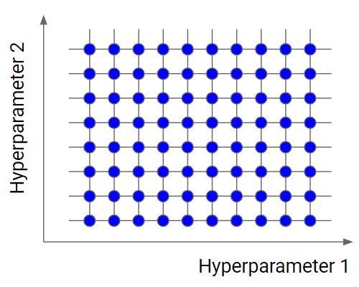
Grid Search
involves searching through a range of values for hyperparameters to find the best subset

Slide 21
Grid Search
involves searching through a range of values for hyperparameters to find the best subset
criterion = {‘gini’, ‘entropy’}
max_depth = {2,3,4,5}
min_impurity_decrease = {0, 0.01, 0.05, 0.1}

Slide 22
Grid Search
involves searching through a range of values for hyperparameters to find the best subset
1) Set the grid with initial guess for parameters
2) Fit model with grid search
3) Repeat process until best model is found.

Slide 23
Python
Notes:
Guidelines
Use a title slide at the beginning of your presentation. There are 9 variations of title slides to choose from.
If you will have a series of slideshows, we recommend using the same style of title slide for each presentation.
Keep your title to no more than 2 lines.
Do not change the font style or font size of the title or subtitle.

